Slide 1
Unit 4 : Data Warehousing Technologies and Implementation
Lecturer : Bijay Mishra

Slide 2
Design of a Data Warehouse: A Business Analysis Framework
Four views regarding the design of a data warehouse
Top-down view
allows selection of the relevant information necessary for the data warehouse
Data source view
exposes the information being captured, stored, and managed by operational systems
Data warehouse view
consists of fact tables and dimension tables
Business query view
sees the perspectives of data in the warehouse from the view of end-user

Slide 3
Data Warehouse Design Process
Top-down, bottom-up approaches or a combination of both
Top-down: Starts with overall design and planning (mature)
Bottom-up: Starts with experiments and prototypes (rapid)
From software engineering point of view
Waterfall: structured and systematic analysis at each step before proceeding to the next
Spiral: rapid generation of increasingly functional systems, short turn around time, quick turn around
Typical data warehouse design process
Choose a business process to model, e.g., orders, invoices, etc.
Choose the grain (atomic level of data) of the business process
Choose the dimensions that will apply to each fact table record
Choose the measure that will populate each fact table record

Slide 4
Multi-Tiered Architecture
Monitor
&
Integrator
OLAP Server
other
sources
Metadata
Analysis
Query
Reports
Data mining
Operational
DBs
Extract
Transform
Load
Refresh
Data
Warehouse
Serve
Data Marts
Data Sources
Data Storage
OLAP Engine
Front-End Tools

Slide 5
Design of a Data Warehouse: Three Data Warehouse Models
Enterprise warehouse
collects all of the information about subjects spanning the entire organization
top down approach
the W. Inmon methodology
Data Mart
a subset of corporate-wide data that is of value to a specific groups of users. Its scope is confined to specific, selected groups, such as marketing data mart
Independent vs. dependent (directly from warehouse) data mart
bottom up approach
the R. Kimball methodology
Virtual warehouse
A set of views over operational databases
Only some of the possible summary views may be materialized

Slide 6
The Data Mart Strategy
The most common approach
Begins with a single mart and architected marts are added over time for more subject areas
Relatively inexpensive and easy to implement
Can be used as a proof of concept for data warehousing
Can postpone difficult decisions and activities
Requires an overall integration plan
The key is to have an overall plan, processes, and technologies for integrating the different marts.
The marts may be logically rather than physically separate.

Slide 7
Enterprise Warehouse Strategy
A comprehensive warehouse is built initially
An initial dependent data mart is built using a subset of the data in the warehouse
Additional data marts are built using subsets of the data in the warehouse
Like all complex projects, it is expensive, time consuming, and prone to failure
When successful, it results in an integrated, scalable warehouse
Even with the enterprise-wide strategy, the warehouse is developed in phases and each phase should be designed to deliver business value.

Slide 8
Data Warehouse Development: A Recommended Approach
Multi-Tier Data Warehouse
Distributed Data Marts
Enterprise Data Warehouse
Data Mart
Data Mart
Model refinement
Model refinement
Define a high-level corporate data model

Slide 9
Extract, Transform and Load (ETL) Definition
Three separate functions combined into one development tool:
Extract - Reads data from a specified source and extracts a desired subset of data.
Transform - Uses rules or lookup tables, or creating combinations with other data, to convert source data to the desired state.
Load - Writes the resulting data to a target database

Slide 10
ETL Overview
ETL, Short for extract, transform, and load are the database functions that are combined into one tool.
ETL is used to migrate data from one database to another, to form data marts and data warehouses and also to convert databases from one format or type to another.
To get data out of the source and load it into the data warehouse – simply a process of copying data from one database to other
Data is extracted from an OLTP database, transformed to match the data warehouse schema and loaded into the data warehouse database
Many data warehouses also incorporate data from non-OLTP systems such as text files, legacy systems, and spreadsheets; such data also requires extraction, transformation, and loading

Slide 11
The ETL Cycle
EXTRACT
The process of reading data from different sources.
TRANSFORM
The process of transforming the extracted data from its original state into a consistent state so that it can be placed into another database.
LOAD
The process of writing the data into the target source.

MIS Systems
(Acct, HR)
TRANSFORM
CLEANSE
Data Warehouse
www data
Legacy
Systems
EXTRACT
LOAD
Archived data

Other indigenous applications
(COBOL, VB, C++, Java)
OLAP
Temporary
Data storage

Slide 12
ETL Processing
ETL is independent yet interrelated steps.
It is important to look at the big picture.
Data acquisition time may include…
Extracts
from
source
systems
Data
Movement
Data
Transfor-
mation
Data
Cleansing
Data
Loading
Index
Mainte-
nance
Statistics
Collection
Backup
Back-up is a major task, it is a Data Warehouse not a cube

Slide 13
ETL is often a complex combination of process and technology that consumes a significant portion of the data warehouse development efforts and requires the skills of business analysts, database designers, and application developers
It is not a one time event as new data is added to the Data Warehouse periodically – i.e. monthly, daily, hourly
Because ETL is an integral, ongoing, and recurring part of a data warehouse. It may be:
Automated
Well documented
Easily changeable
When defining ETL for a data warehouse, it is important to think of ETL as a process, not a physical implementation

Slide 14
Extraction, Transformation, and Loading (ETL) Processes
Data Extraction
Data Cleansing
Data Transformation
Data Loading
Data Refreshing

Slide 15
Data Extraction

Slide 16
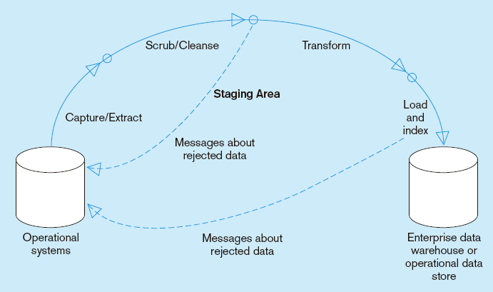
Capture/Extract…obtaining a snapshot of a chosen subset of the source data for loading into the data warehouse
Static extract = capturing a snapshot of the source data at a point in time
Incremental extract = capturing changes that have occurred since the last static extract

Slide 17
Data is extracted from heterogeneous data sources
Each data source has its distinct set of characteristics that need to be managed and integrated into the ETL system in order to effectively extract data.

Slide 18
ETL process needs to effectively integrate systems that have different:
DBMS
Operating Systems
Hardware
Communication protocols
Need to have a logical data map before the physical data can be transformed
The logical data map describes the relationship between the extreme starting points and the extreme ending points of your ETL system usually presented in a table or spreadsheet

Slide 19
Target |  |  | Source |  |  | Transformation
Table Name | Column Name | Data Type | Table Name | Column Name | Data Type
The content of the logical data mapping document has been proven to be the critical element required to efficiently plan ETL processes.
The table type gives us our queue for the ordinal position of our data load processes—first dimensions, then facts.
This table must depict, without question, the course of action involved in the transformation process
The transformation can contain anything from the absolute solution to nothing at all. Most often, the transformation can be expressed in SQL. The SQL may or may not be the complete statement

Slide 20
Some ETL Tools
Tool | Vendor
Oracle Warehouse Builder (OWB) | Oracle
Data Integrator (BODI) | Business Objects
IBM Information Server (Ascential) | IBM
SAS Data Integration Studio | SAS Institute
PowerCenter | Informatica
Oracle Data Integrator (Sunopsis) | Oracle
Data Migrator | Information Builders
Integration Services | Microsoft
Talend Open Studio | Talend
DataFlow | Group 1 Software (Sagent)
Data Integrator | Pervasive
Transformation Server | DataMirror
Transformation Manager | ETL Solutions Ltd.
Data Manager | Cognos
DT/Studio | Embarcadero Technologies
ETL4ALL | IKAN
DB2 Warehouse Edition | IBM
Jitterbit | Jitterbit
Pentaho Data Integration | Pentaho

Slide 21
Data Cleansing

Slide 22
Data Cleansing
Data Warehouse is NOT just about arranging data, but should be clean for overall health of organization. “We drink clean water”!
Sometime called as Data Scrubbing or Cleaning.
ETL software contains rudimentary data cleansing capabilities
Specialized data cleansing software is often used. Leading data cleansing vendors include Vality (Integrity), Harte-Hanks (Trillium), and Firstlogic (i.d.Centric)

Slide 23
Why Cleansing?
Data warehouse contains data that is analyzed for business decisions
Source systems contain “dirty data” that must be cleansed.
More data and multiple sources could mean more errors in the data and harder to trace such errors
Results in incorrect analysis
Enormous problem, as most data is dirty. (GIGO)

Slide 24
Reasons for “Dirty” Data
Dummy Values
Absence of Data
Multipurpose Fields
Cryptic Data
Contradicting Data
Inappropriate Use of Address Lines
Violation of Business Rules
Reused Primary Keys,
Non-Unique Identifiers
Data Integration Problems

Slide 25
Examples:
Dummy Data Problem:
A clerk enters 999-99-9999 as a SSN rather than asking the customer for theirs.
Reused Primary Keys:
A branch bank is closed. Several years later, a new branch is opened, and the old identifier is used again.

Slide 26
Inconsistent Data Representations
Same data, different representation
Date value representations Examples: 970314 1997-03-14 03/14/1997 14-MAR-1997
March 14 1997 2450521.5 (Julian date format)
Gender value representations Examples: - Male/Female - M/F - 0/1

Slide 27
Scrub/Cleanse…uses pattern recognition and AI techniques to upgrade data quality
Fixing errors: misspellings, erroneous dates, incorrect field usage, mismatched addresses, missing data, duplicate data, inconsistencies
Also: decoding, reformatting, time stamping, conversion, key generation, merging, error detection/logging, locating missing data

Slide 28
Two Classes of Anomalies
Coverage Problems
Missing values
Missing Tuples or records
Key-based classification problems
Primary key problems
Non-Primary key problems

Slide 29
1. Coverage Problems
Missing Attribute
Result of omissions while collecting the data.
A constraint violation if we have null values for attributes where NOT NULL constraint exists.
Case more complicated where no such constraint exists.
Have to decide whether the value exists in the real world and has to be deduced here or not.

Slide 30
Coverage
Missing values
Missing records

Slide 31
Why Missing Rows/Value?
Equipment malfunction (bar code reader, keyboard etc.)
Inconsistent with other recorded data and thus deleted.
Data not entered due to misunderstanding/illegibility.
Data not considered important at the time of entry (e.g. Y2K).

Slide 32
Handling missing data
Dropping records.
“Manually” filling missing values.
Using a global constant as filler.
Using the attribute mean (or median) as filler.
Using the most probable value as filler.

Slide 33
2. Key-based Classification Problems
Primary key problems
Same PK but different data.
Same entity with different keys.
PK in one system but not in other.
Same PK but in different formats.

Slide 34
Non primary key problems
Different encoding in different sources.
Multiple ways to represent the same information.
Sources might contain invalid data.
Two fields with different data but same name.
Required fields left blank.
Data erroneous or incomplete.
Data contains null values.

Slide 35
Data Quality paradigm
Correct
Unambiguous
Consistent
Complete
Data quality checks are run at 2 places - after extraction and after cleaning and confirming additional check are run at this point

Slide 36
Steps in Data Cleansing
Parsing
Correcting
Standardizing
Matching
Consolidating

Slide 37
Parsing
The record is broken down into atomic data elements.
Parsing locates and identifies individual data elements in the source files and then isolates these data elements in the target files.
Examples include parsing the first, middle, and last name; street number and street name; and city and state.

Slide 38
Correcting
External data, such as census data, is often used in this process.
Corrects parsed individual data components using sophisticated data algorithms and secondary data sources.
Example include replacing a vanity address and adding a zip code.

Slide 39
Standardizing
Companies decide on the standards that they want to use.
Standardizing applies conversion routines to transform data into its preferred (and consistent) format using both standard and custom business rules.
Examples include adding a pre name, replacing a nickname, and using a preferred street name.

Slide 40
Matching
Commercial data cleansing software often uses AI techniques to match records.
Searching and matching records within and across the parsed, corrected and standardized data based on predefined business rules to eliminate duplications.
Examples include identifying similar names and addresses.

Slide 41
Consolidating
All of the data are now combined in a standard format.
Analyzing and identifying relationships between matched records and consolidating/merging them into ONE representation.

Slide 42
Data Staging
Data staging is used in cleansing, transforming, and integrating the data.
Often used as an interim step between data extraction and later steps
Accumulates data from asynchronous sources using native interfaces, flat files, FTP sessions, or other processes
At a predefined cutoff time, data in the staging file is transformed and loaded to the warehouse
There is usually no end user access to the staging file
An operational data store may be used for data staging

Slide 43
Data Transformation

Slide 44
Data Transformation
It is the main step where the ETL adds value.
Actually changes data and provides guidance whether data can be used for its intended purposes.
Performed in staging area.

Slide 45
Transform = convert data from format of operational system to format of data warehouse
Record-level:
Selection–data partitioning
Joining–data combining
Aggregation–data summarization
Field-level:
single-field–from one field to one field
multi-field–from many fields to one, or one field to many

Slide 46
Basic Tasks
Selection
Splitting/Joining
Conversion
Summarization
Enrichment

Slide 47
Data Transformation : Conversion
Convert common data elements into a consistent form i.e. name and address.
Translation of dissimilar codes into a standard code.
Field format Field data
First-Family-title Bijay Mishra, Lecturer
Family-title-comma-first Mishra Lecturer, Bijay
Family-comma-first-title Mishra, Bijay Lecturer
F/NO-2
F-2
FL.NO.2
FL.2
FL/NO.2
FL-2
FLAT-2
FLAT#
FLAT,2
FLAT-NO-2
FL-NO.2
Natl. ID NID
National ID NID
FLAT No. 2

Slide 48
Data representation change
EBCIDIC to ASCII
Operating System Change
Mainframe (MVS) to UNIX
UNIX to NT or XP
Data type change
Program (Excel to Access), database format (FoxPro to Access).
Character, numeric and date type.
Fixed and variable length.

Slide 49
Data Transformation : Summarization
Values are summarized to obtain total figures which are subsequently calculated and stored at multiple levels as business fact in multidimensional fact tables.

Slide 50
Data Transformation : Enrichment
Data elements are mapped from source tables and files to destination fact and dimension tables.
Default values are used in the absence of source data.
Fields are added for unique keys and time elements.
Parsed Data
First Name: BIJAY
Family Name: MISHRA
Title: LECTURER
College: WHITEHOUSE INTERNATIONAL COLLEGE,
College Location: KHUMALTAR, LALITPUR
Zone: RAWALPINDI
Mobile: 9841695609
Code: 46200
Input Data
BIJAY MISHRA LECTURER
WHITEHOUSE INTERNATIONAL COLLEGE,
KHUMALTAR, LALITPUR
BAGMATI, 9841695609

Slide 51
Transformation - Confirming
Structure Enforcement
Tables have proper primary and foreign keys
Obey referential integrity
Data and Rule value enforcement
Simple business rules
Logical data checks

Slide 52
Stop
Yes
Staged Data
Cleaning
And
Confirming
Fatal Errors
No
Loading

Slide 53
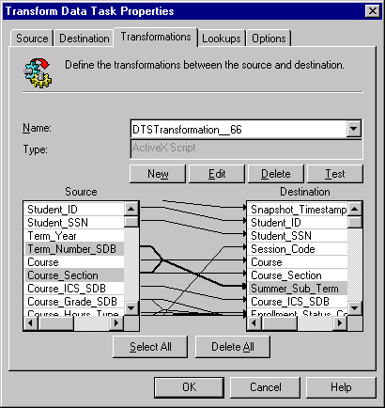
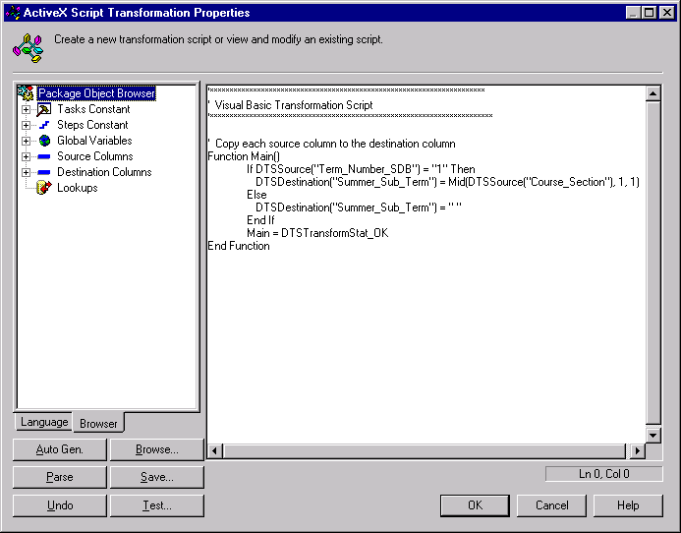
Data Warehouse Data Transformation Services

Slide 54
Data Loading

Slide 55
Data Loading
Most loads involve only change data rather than a bulk reloading of all of the data in the warehouse.
Data are physically moved to the data warehouse
The loading takes place within a “load window”
The trend is to near real time updates of the data warehouse as the warehouse is increasingly used for operational applications

Slide 56
Load/Index= place transformed data into the warehouse and create indexes
Refresh mode: bulk rewriting of target data at periodic intervals
Update mode: only changes in source data are written to data warehouse

Slide 57
The loading process can be broken down into 2 different types:
Initial Load
Continuous Load (loading over time)

Slide 58
Initial Load
Consists of populating tables in warehouse schema and verifying data readiness
Examples:
DTS – data transformation services
Backup utility – batch copy
SQL*Loader
Native Database Languages (T-SQL, PL/SQL, etc.)

Slide 59
Continuous Loads
Must be scheduled and processed in a specific order to maintain integrity, completeness, and a satisfactory level of trust
Should be the most carefully planned step in data warehousing or can lead to:
Error duplication
Exaggeration of inconsistencies in data
Must be during a fixed batch window (usually overnight)
Must maximize system resources to load data efficiently in allotted time
Ex. Red Brick Loader can validate, load, and index up to 12GB of data per hour on an SMP system

Slide 60
Loading Dimensions
Physically built to have the minimal sets of components
The primary key is a single field containing meaningless unique integer – Surrogate Keys
The DW owns these keys and never allows any other entity to assign them
De-normalized flat tables – all attributes in a dimension must take on a single value in the presence of a dimension primary key.
Should possess one or more other fields that compose the natural key of the dimension

Slide 61
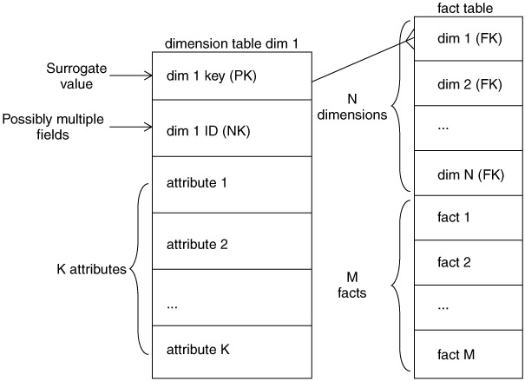

Slide 62
The data loading module consists of all the steps required to administer slowly changing dimensions (SCD) and write the dimension to disk as a physical table in the proper dimensional format with correct primary keys, correct natural keys, and final descriptive attributes.
Creating and assigning the surrogate keys occur in this module.
The table is definitely staged, since it is the object to be loaded into the presentation system of the data warehouse.

Slide 63
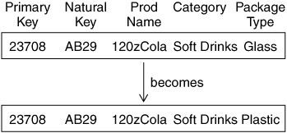
Type 1 Dimension
When DW receives notification that an existing row in dimension has changed it gives out 3 types of responses:
Type 1
Type 2
Type 3

Slide 64
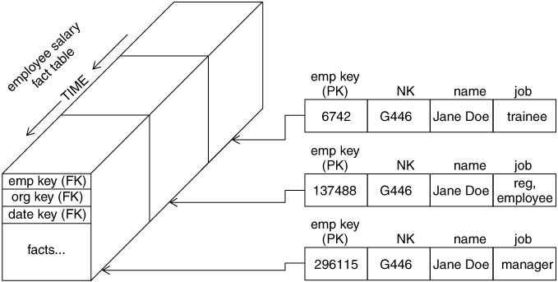
Type 2 Dimension

Slide 65
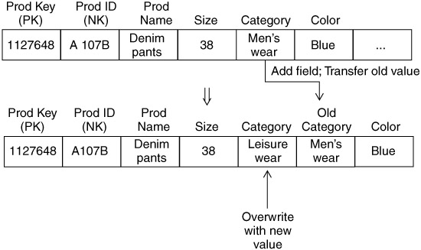
Type 3 Dimensions

Slide 66
Loading Facts
Fact tables hold the measurements of an enterprise.
The relationship between fact tables and measurements is extremely simple.
If a measurement exists, it can be modeled as a fact table row.
If a fact table row exists, it is a measurement

Slide 67
Key Building Process - Facts
When building a fact table, the final ETL step is converting the natural keys in the new input records into the correct, contemporary surrogate keys
ETL maintains a special surrogate key lookup table for each dimension. This table is updated whenever a new dimension entity is created and whenever a Type 2 change occurs on an existing dimension entity
All of the required lookup tables should be pinned in memory so that they can be randomly accessed as each incoming fact record presents its natural keys. This is one of the reasons for making the lookup tables separate from the original data warehouse dimension tables.

Slide 68
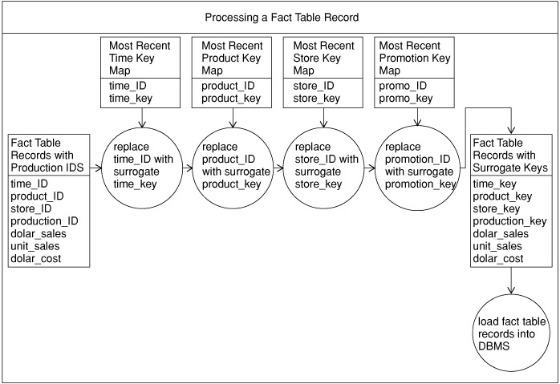

Slide 70
Loading Fact Tables
Managing Indexes
Performance Killers at load time
Drop all indexes in pre-load time
Segregate Updates from inserts
Load updates
Rebuild indexes

Slide 71
Managing Partitions
Partitions allow a table (and its indexes) to be physically divided into minitables for administrative purposes and to improve query performance
The most common partitioning strategy on fact tables is to partition the table by the date key. Because the date dimension is preloaded and static, you know exactly what the surrogate keys are
Need to partition the fact table on the key that joins to the date dimension for the optimizer to recognize the constraint.
The ETL team must be advised of any table partitions that need to be maintained.

Slide 72
Data Refreshing

Slide 73
Data Refresh
Propogate updates from sources to the warehouse
Issues:
when to refresh
how to refresh -- refresh techniques
Set by administrator depending on user needs and traffic

Slide 74
When to Refresh?
periodically (e.g., every night, every week) or after significant events
on every update: not warranted unless warehouse data require current data (up to the minute stock quotes)
refresh policy set by administrator based on user needs and traffic
possibly different policies for different sources

Slide 75
Refresh Techniques
Full Extract from base tables
read entire source table: too expensive
maybe the only choice for legacy systems

Slide 76
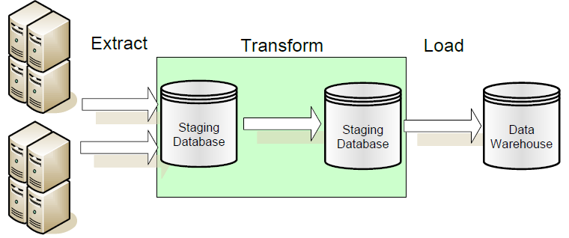
ETL vs. ELT
ETL: Extract, Transform, Load in which data transformation takes place on a separate transformation server.

Slide 77
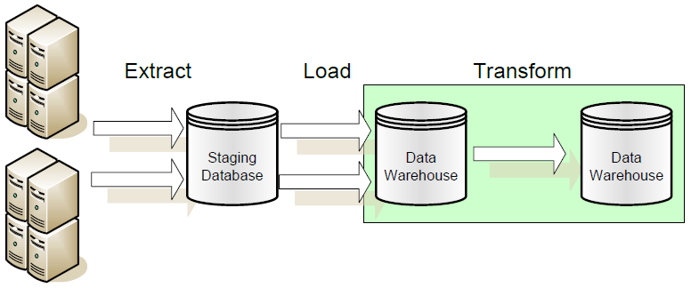
ELT: Extract, Load, Transform in which data transformation takes place on the data warehouse server.

Slide 78
Data warehouse support in SQL Server 2008/Oracle 11g
Oracle supports the ETL process with their "Oracle Warehouse Builder" product. Many new features in the Oracle9i database will also make ETL processing easier.
Data Warehouse Builder (or Oracle Data Mart builder), Oracle Designer, Oracle Express, Express Objects, etc. tools can be used to design and build a warehouse.

Slide 79
SQL Server 2008 introduced what we call the Management Data Warehouse.
The Management Data Warehouse is a relational database that contains data that is collected from a server using the new SQL Server 2008 Data Collection mechanism.
The Warehouse consists primarily of the following components:
An extensible data collector
Stored procedures which allow the DBA to create their own data collection set and own the resultant data collection items
Three Data Collections Sets which are delivered with SQL Server 2008 and which can be enabled at any time
Standard reports delivered with SQL Server 2008 Management Studio display data collected by the three predefined Data Collection Sets

Slide 80
Questions?

Slide 81
References
D. Pyle. Data Preparation for Data Mining. Morgan Kaufmann, 1999.
R. Wang, V. Storey, and C. Firth. A framework for analysis of data quality research. IEEE Trans. Knowledge and Data Engineering, 7:623-640, 1995.
J. Han and M. Kamber. Data Mining: Concepts and Techniques. Morgan Kaufmann, 2000.
C. Imhoff, N. Galemmo, and J. G. Geiger. Mastering Data Warehouse Design: Relational and Dimensional Techniques. John Wiley, 2003
W. H. Inmon. Building the Data Warehouse. John Wiley, 1996
R. Kimball and M. Ross. The Data Warehouse Toolkit: The Complete Guide to Dimensional Modeling. 2ed. John Wiley, 2002
http://blogs.msdn.com

Slide 82
End of Unit 4

Slide 83
Thank you !!!

